Slide 1

Welcome to the
Italy - Milan

Slide 2

Day's Schedule
Time | Activity / Session Title | Speaker
9:00 – 9:30 | Guest arrival, Registration | Staff
9:30 – 10:00 | Keynote | Marco Dal Pino
10:00 – 10:50 | Usare Azure IaaS in modo serio. Casi d'uso reali. | Francesco Valerio Buccoli
10:50 – 11:05 | Break
11:05 – 11:55 | Azure Pipelines for Githubbers | Massimo Bonanni
11:55 – 12:45 | Ricerche intelligenti con Cognitive Search | Marco Minerva – Riccardo Cappello
12:45 – 14:15 | Lunch & Session: Introduction to .NET Core Microservices Development with AzureDevSpaces | Giancarlo Lelli
14:15 – 15:05 | Industrial IoT: Dalle parole ai fatti | Riccardo Zamana
15:05 – 15:20 | Break
15:20 – 16:10 | Azure PaaS Databases | Gianluca Hotz
16:10 – 17:00 | Automate deeply with the power of PaaS | Roberto Freato
17:00 – 17:30 | Closing Remarks, Questions, Raffle & Guest Departure | Staff

Slide 3
Automate deeply with the power of PaaS
Roberto Freato
Consultant / Author / Solution Architect

Slide 4









A BIG thank you to the 2019 Global Sponsors!

Slide 5
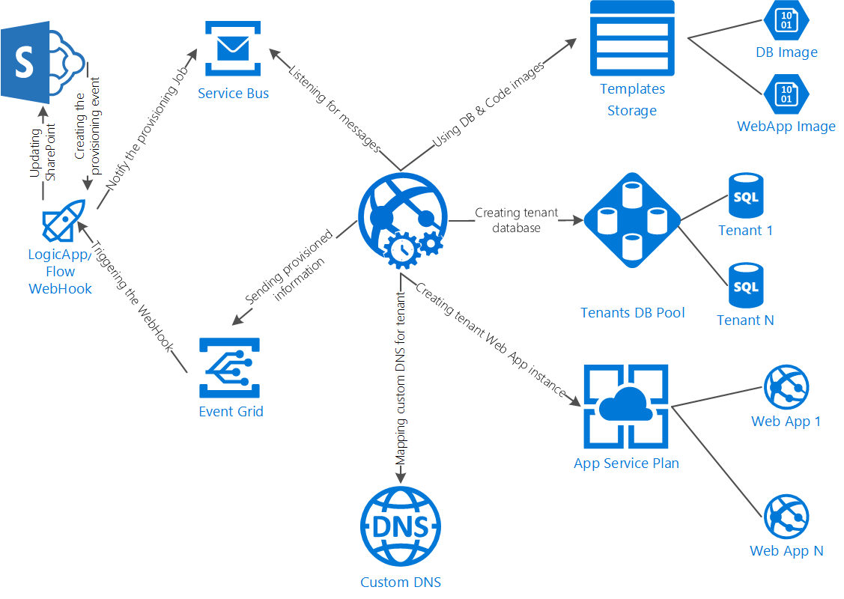

Slide 6
Let’s do it

Slide 7
Automate deeply with the power of PaaS
Roberto Freato
Consultant / Author / Solution Architect
DEMOS and Slides available on GitHub:
https://github.com/childotg/Events.2019

